Slide 1
Ch03 Program Flow Control
Highlights of the chapter:
3.1 Flow of the program
3.2 Sequential structure
3.3 Selection of structure
3.4 Circular structure
3.5 Comprehensive application: complex graphic drawing with turtle module

Slide 2

3.1 Flow of the program
Input, Processing and Output (IPO)
The program receives the data to be processed through the input (Input)); then performs the corresponding processing (Process); and finally returns the result of the processing through the output (Output).
(1) Input data
Input is the beginning of a program. There are various sources of data to be processed by the program, forming a variety of input methods, including interactive input, parameter input, random data input, file input, network input, etc.

Slide 3
3.1 Flow of the program
(2) Processing of data
Processing is the process by which a program computes input data to produce an output. Approaches to computational problems are collectively referred to as "algorithms".
(3) Output results
Output is the way a program outputs its results. Program output methods include console output, graphical output, file output, network output, etc.
[Example 3.1] IPO description of a program to calculate the surface area and volume of a sphere
input(I): Input r which is the radius of the sphere
process(P): Calculate the surface area of a sphere s = 4 * math.pi * r * r
Calculate the volume of a sphere v = 4 * math.pi * r * r * r / 3
output(O): Output the s and v

Slide 4
Programs = Algorithms + Data Structures
Algorithms are methods for performing specific tasks
A data structure is a way of storing data that helps to solve a specific problem
Describing algorithms: natural language descriptions & pseudo-code
[Example 3.2] Natural Language Description of an Algorithm for Solving for the Greatest Common Denominator of Two Integers
One algorithm for solving for the Greatest Common Divisor (GCD) of two integers is the Rollover Division, also known as the Euclidean Algorithm. The natural language description of the Tumbling and Dividing algorithm is as follows.
(1) For two known positive integers m and n, such that m > n.
(2) Divide m by n to obtain the remainder r.
(3) If r ≠ 0, let m ← n, n ← r, repeat step (2) and continue m divided by n to get the new remainder r. If still r ≠ 0, repeat the process until r = 0. The final m is the greatest common divisor.

Slide 5
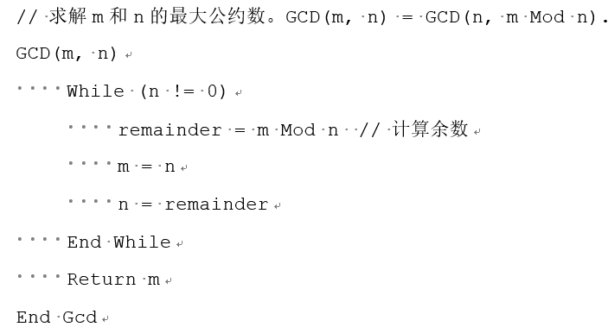
Programs = Algorithms + Data Structures
[Example 3.3] Pseudo-code description of the tumbling division algorithm for solving the greatest common divisor of two integers

Slide 6

[Example 3.4] Python code implementation of solving for the greatest common divisor of two integers (gcdTest.py)
# Solve for the greatest common divisor of m and n. GCD(m, n) = GCD(n, m Mod n)
def gcd(m,n).
if (m < n).
m, n = n, m
while (n ! = 0).
remainder = m % n # Calculate the remainder
m = n
n = remainder
return m
if __name__ == '__main__'.
print(24,36, "The greatest common divisor of:",gcd(24,36))

Slide 7
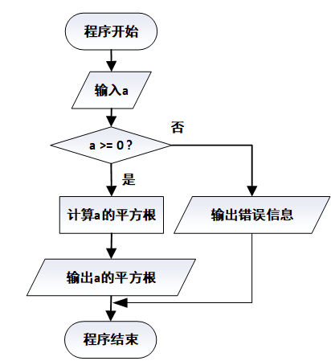
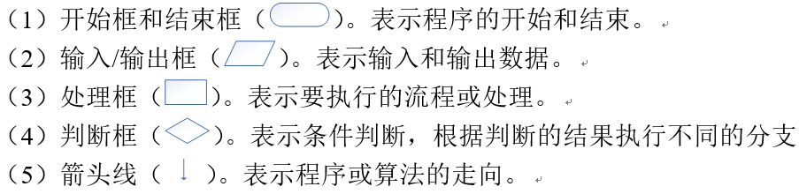
program flow chart
Also known as a block diagram, it is a graphical representation that describes the specific steps of a program run
The basic elements of a flowchart are mainly the following
[Example 3.5] Use a program flowchart (shown in Figure 3-2) to describe a program that calculates the square root of the input data a

Slide 8
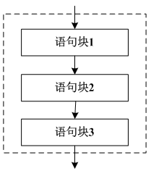
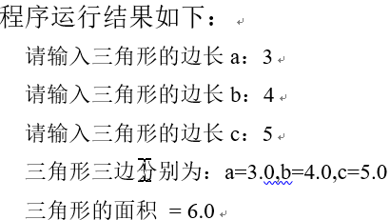
3.2 Sequential structure
[Example 3.6] Sequential Structure Example (area.py): Know the lengths of the three sides of a triangle (assume for simplicity that the three sides can form a triangle) and find the area of the triangle.
import math
a = float(input("Please enter the side length a of the triangle:"))
b = float(input("Please enter the side length b of the triangle:"))
c = float(input("Please enter the side length c of the triangle:"))
h = (a + b + c) / 2 # half the perimeter of the triangle
area = math.sqrt(h*(h-a)*(h-b)*(h-c))#Triangle area
print(str.format("The three sides of the triangle are: a={0},b={1},c={2}", a, b, c))
print(str.format("Area of triangle = {0}", area))

Slide 9
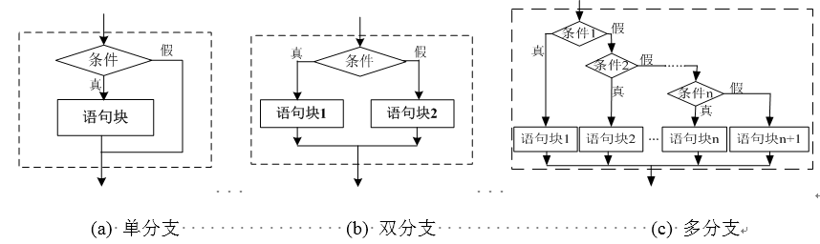
3.3 Selection of structure
Forms of branching structure:
Single, double and multi-branching

Slide 10

single branch structure
Grammatical form of the single branch structure of an if statement:
When the value of the conditional expression is true (True), the statement (block) following the if is executed, otherwise no action is taken and control goes to the end of the if statement

Slide 11
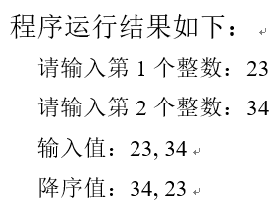
single branch structure
[Example 3.7] Single branch structure example (if_2desc.py): input two numbers a and b, compare the size of the two, so that a greater than b
a = int(input("Please enter the 1st integer:")) #Input integer 1
b = int(input("Please enter the 2nd integer:")) #Input integer 2
print(str.format("Input values: {0}, {1}", a, b)) # Display the two input integers
if (a < b): # if a is less than b
a, b = b, a #a and b swap
print(str.format("Descending values: {0}, {1}", a, b)) #Output descending sort result

Slide 12
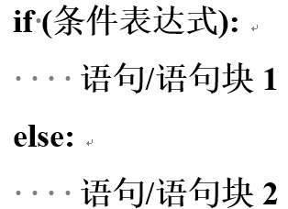
two-branch architecture
Grammatical forms of if statements with double branching structure
When the value of the conditional expression is true, the statement after if (block) 1 is executed, otherwise the statement after else (block) 2 is executed.
conditional expression

Slide 13

[Example 3.8] Calculating Segmented Functions
(1) Utilizing a single branch structure to achieve
(2) Utilizing the double branch structure to achieve
(3) Utilizing Conditional Operator Statements to Achieve
if (x>=0).
y = math.sin(x) + 2 * math.sqrt(x + math.exp(4)) - math.pow(x + 1, 3)
if (x<0).
y = math.log(-5 * x) - math.fabs(x * x - 8 * x) / (7 * x) + math.e
if (x>=0).
y = math.sin(x) + 2 * math.sqrt(x + math.exp(4)) - math.pow(x + 1, 3)
else.
y = math.log(-5 * x) - math.fabs(x * x - 8 * x) / (7 * x) + math.e
y = (math.sin(x) + 2 * math.sqrt(x + math.exp(4)) - math.pow(x + 1, 3)) if ((x>=0)) else \
(math.log(-5 * x) - math.fabs(x * x - 8 * x) / (7 * x) + math.e)

Slide 14
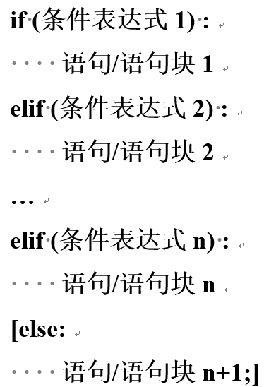
multibranch structure
Grammatical forms of if statements with multiple branching structures

Slide 15
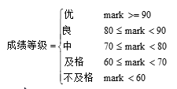
[Example 3.9] Converting a Percentage System to a 5-Point System
Conversion of the percentage score mark to a five-point rating scale (excellent, good, fair, pass, fail) grade
Method I:
mark = int(input("Please enter a score:"))
if (mark >= 90): grade = "Excellent"
elif (mark >= 80): grade = "good"
elif (mark >= 70): grade = "medium"
elif (mark >= 60): grade = "Pass"
else: grade = "Fail"
Method II:
if (mark >= 90): grade = "excellent"
elif (mark >= 80 and mark < 90): grade = "good"
elif (mark >= 70 and mark < 80): grade = "medium"
elif (mark >= 60 and mark < 70): grade = "Pass"
else: grade = "Fail"
Method Three:
if (mark >= 60): grade = "Pass"
elif (mark >= 70): grade = "medium"
elif (mark >= 80): grade = "good"
elif (mark >= 90): grade = "Excellent"
else: grade = "Fail"

Slide 16
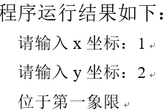
[Example 3.10] Determining the quadrant of a coordinate point
Know the coordinate point (x,y) and determine the quadrant in which it is located (if_coordinate.py)
x = int(input("请输入x坐标："))
y = int(input("请输入y坐标："))
if (x == 0 and y == 0): print("位于原点")
elif (x == 0): print("位于y轴")
elif (y == 0): print("位于x轴")
elif (x > 0 and y > 0): print("位于第一象限")
elif (x < 0 and y > 0): print("位于第二象限")
elif (x < 0 and y < 0): print("位于第三象限")
else: print("位于第四象限")

Slide 17
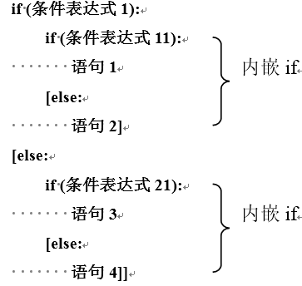
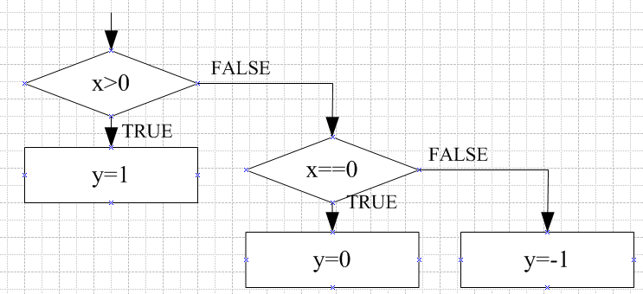
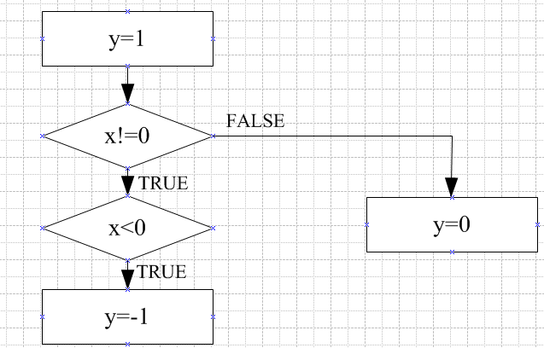
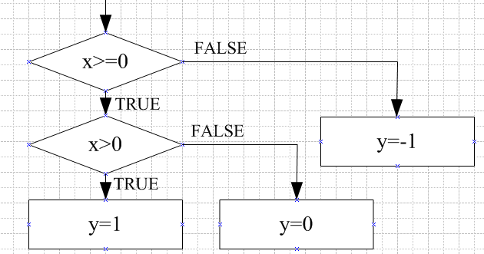
Nesting of if statements
[E 3.11] Compute the segmented function:
Method 1 (multi-branch structure):
if (x > 0): y = 1
elif (x == 0): y = 0
else: y = -1
Method 2 (if statement nested structure):
if (x >= 0).
if (x > 0): y = 1
else: y = 0
else: y = -1
Method Three:
y = 1
if (x ! = 0).
if (x < 0): y = -1
else: y = 0

Slide 18
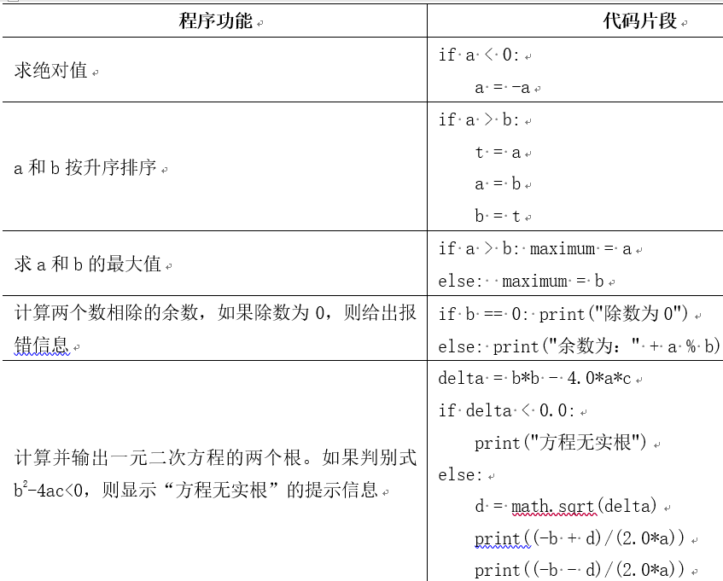
Typical Sample Code for if Statements

Slide 19
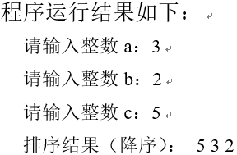
Examples of choice structure synthesis (1)
[Example 3.12] Input three numbers, sorted in descending order (if_3desc.py)
First a is compared with b such that a > b; then a is compared with c such that a > c, when a is largest; and finally b is compared with c such that b > c.
a = int(input("请输入整数a："))
b = int(input("请输入整数b："))
c = int(input("请输入整数c："))
if (a < b):
a, b=b, a #a和b交换，使得a>b
if (a < c):
a, c=c, a #a和c交换，使得a>c
if (b < c):
b, c=c, b #b和c交换，使得b>c
print("排序结果（降序）：", a, b, c)

Slide 20
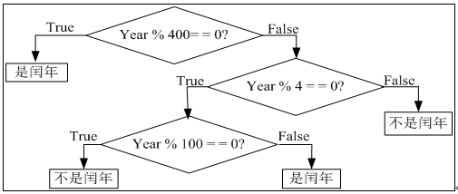
Comprehensive examples of choice structures (2)
[3.13] Program (leapyear.py) to determine whether a year is a leap year. The conditions for determining a leap year are: the year is divisible by 4 but not by 100, or is divisible by 400
Method one. Use a logical expression containing all the leap year conditions:
if ((y % 4 == 0 and y % 100 ! = 0) or y % 400 == 0).
print("It's a leap year")
else: print("Not a leap year")
Method Three. Use if-elif statements:
if (y % 400 == 0): print("It's a leap year")
elif (y % 4 ! = 0): print("Not a leap year")
elif (y % 100 == 0): print("Not a leap year")
else: print("it's a leap year")
Method two. Use nested if statements:
if (y % 400 == 0): print("It's a leap year.")
else.
if (y % 4 == 0).
if (y % 100 == 0): print("Not a leap year")
else: print("it's a leap year")
else: print("Not a leap year")
Method four. Use the calendar module's isleap function to determine leap years.
if (calendar.isleap(y)): print("It's a leap year")
else: print("Not a leap year")

Slide 21
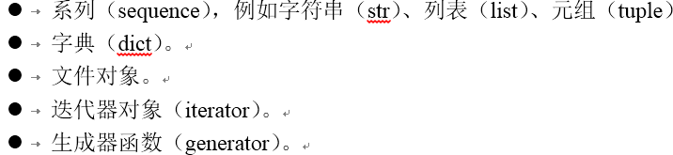


3.4 Circular structure (1)
For and while statements to implement a loop structure.
Iterable objects (iterable)
for loop
>>> for i in (1,2,3):
print(i, i**2, i**3)

Slide 22

3.4 Circular structures (2)
range object
Starts at start and ends at stop (without stop). If an optional step is specified, the sequence grows by step
[Example 3.14] Using a for loop to find the sum of all the odd numbers from 1 to 100 and the sum of the even numbers (for_sum1_100.py)
>>> for i in range(1,11): print(i, end=' ') #Output: 1 2 3 4 5 6 7 8 9 10
1 2 3 4 5 6 7 8 9 10
>>> for i in range(1,11,3): print(i, end=' ') #Output: 1 4 7 10
1 4 7 10
sum_odd = 0; sum_even = 0 # Loop to assign initial value
for i in range(1, 101): #i=1~100
if i % 2 ! = 0: #Odd
sum_odd += i # odd sums
else: #Even
sum_even += i #Even sums
print("Sum of all odd numbers from 1 to 100:", sum_odd)
print("Sum of all even numbers from 1 to 100:", sum_even)

Slide 23


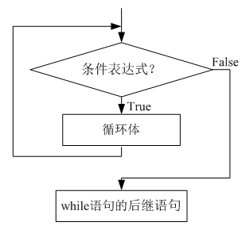

while loop (1)
[Example 3.15] Use a while loop to find , and the sum of all odd and even numbers in 1 to 100 (while_sum.py)
i = 1; sum_all = 0; sum_odd = 0; sum_even = 0
while (i <= 100).
sum_all += i # sum of all numbers
if (i % 2 == 0): #Even numbers
sum_even += i #Even sums
else: #Odd
sum_odd += i # odd sums
i += 1
print("sum = %d, odd sum = %d, even sum = %d" % (sum_all, sum_odd, sum_even))

Slide 24


while loop (2)
[Example 3.16] Use the following approximate formula to find the value of the base e of the natural logarithm until the absolute value of the last term is less than 10⁻⁶（while_e.py）
i = 1; e = 1; t = 1
while (1/t >= pow(10,-6)).
t *= i
e += 1 / t
i += 1
print("e =", e)

Slide 25
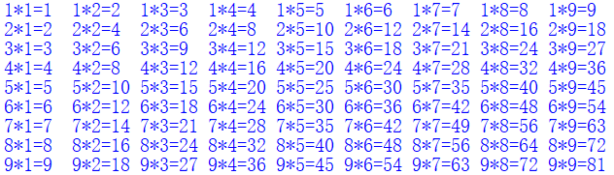
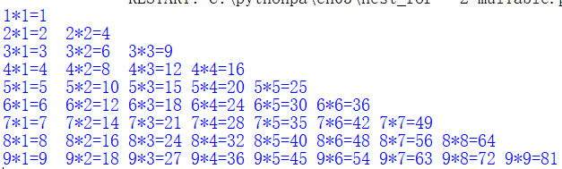
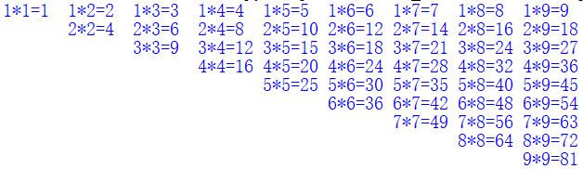
Nesting of loops
A loop that contains another complete loop structure within a loop is called a nested loop.
[Example 3.17] Using nested loops to print a nine-nine multiplication table that runs as shown in figure (nest_for.py)
Think: Please modify the program to print 2 separate multiplication tables for the 999 as shown in the figure:
for i in range(1, 10): # outer loop
s = ""
for j in range(1, 10): # inner loop
s += str.format("{0:1}*{1:1}={2:<2} ", i, j, i * j)

Slide 26
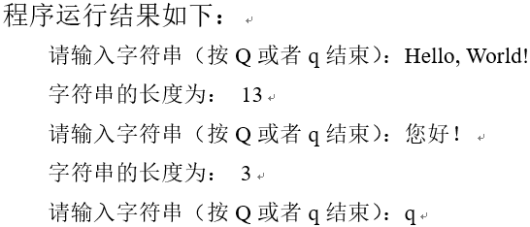
break statement (1)
Used to exit the for and while loops, i.e., to end the loop early and then execute the successor statement of the loop statement.
When multiple for and while statements are nested within each other, the break statement is applied only to the innermost statement, i.e., the break statement can only jump out of the nearest layer of the loop.
[Example 3.18] Terminating a Loop Using the break Statement (break.py)
while True:
s = input('Please enter a string (press Q or q to end):')
if s.upper() == 'Q'.
break
print('The length of the string is:', len(s))

Slide 27
break statement (2)
[Example 3.19] Programming (prime1.py and prime2.py) to determine whether any of the input positive integers is prime or not
Method 1 (utilizing a for loop and break statement):
import math
m = int(input("Please enter an integer (>1):"))
k = int(math.sqrt(m))
for i in range(2, k + 2):
if m % i == 0.
break #Divisible, definitely not prime, end loop
if i == k+1 : print(m, "It's prime!")
else: print(m, "It's a composite number!")
Method 2 (using while loop and bool variables):
import math
m = int(input("Please enter an integer (>1):"))
k = int(math.sqrt(m))
flag = True # Assume that the input integer is prime.
i = 2
while (i <= k and flag == True)::
if (m % i == 0): flag = False #Divisible, definitely not prime, end loop
else: i += 1
if (flag == True): print(m, "It's prime!")
else: print(m, "It's a composite number!")

Slide 28
continue statement (1)
End the loop, i.e., skip the statements in the loop that have not been executed since continue, return to the beginning of the loop, and determine whether to execute the next loop according to the loop conditions.
Difference between continue statement and break statement
The continue statement only ends the loop and returns to the beginning of the loop, where the next loop will begin if the loop conditions are met; the break statement ends the loop and jumps to the next statement in the loop.

Slide 29
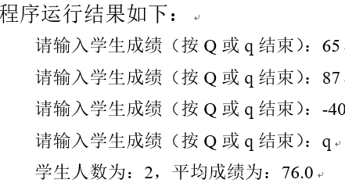
continue statements (2)
[Example 3.20] Use the continue statement to skip the loop. Ask for a number of student grades (press Q or q to end) and reenter if the grade is <0. Counting the number of students and their grade point averages
num = 0; scores = 0; #Initialize the number of students and scores and
while True:
s = input('Please enter student grades (press Q or q to end):')
if s.upper() == 'Q'.
break
if float(s) < 0: # grades must be >= 0
continue
num += 1 #count students
scores += float(s) #calculate the sum of scores

Slide 30
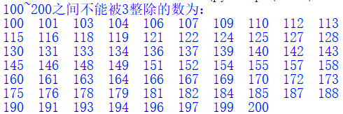
continue statements (3)
[Example 3.21] Displaying numbers between 100 and 200 that are not divisible by 3 (continue_div3.py). Requires a line to display 10 numbers
j = 0 # Controls the number of values displayed on a line
print('The number between 100 and 200 that is not divisible by 3 is:')
for i in range(100, 200 + 1):
if (i % 3 == 0): continue # skip numbers divisible by 3
print(str.format("{0:<5}",i), end="") #Each number takes up 5 positions, with spaces after the shortfall, and no line breaks
j += 1
if (j % 10 == 0): print() # line breaks after showing 10 numbers

Slide 31
Dead loop (infinite loop)
If the loop control condition in the while loop structure is always true, the loop will continue indefinitely and the program will run forever, thus forming a dead loop.
When a program deadlocks, it causes the program to be unresponsive; or it causes constant output (e.g., console output, file writes, printouts, etc.)
Inserting the debug output statement print into the program's loop body allows you to determine if the program is a dead loop. Note that some programs with very complex algorithms may take a long time to run but are not dead loops

Slide 32
Dead loop (infinite loop)
You can use the shortcut <Ctrl>+<c> to terminate the current program.
Example 3.17: Dead Loop Example (infinite.py) 2
import math
while True: #The loop condition is always true
num = float(input("Please enter a positive number:"))
print(str(num), "The square root of:", math.sqrt(num))
print("Good bye!")

Slide 33
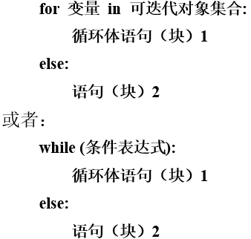
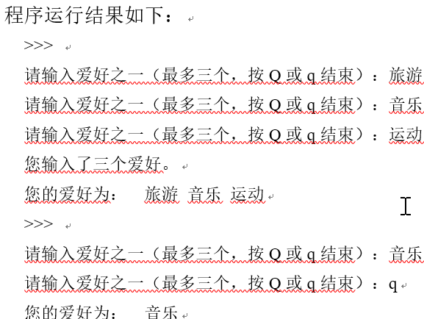
else clause
[Example 3.23] Using the else clause of a for statement (for_else.py)
hobbies = ""
for i in range(1, 3 + 1):
s = input('Please enter one of the hobbies (up to three, press Q or q to end):')
if s.upper() == 'Q'.
break
hobbies += s + ' '
else.
print('You have entered three hobbies.')
print('Your hobbies are:', hobbies)

Slide 34
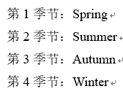
The enumerate function and loops
Python's for loop iterates directly over the elements of a collection of objects. If you need to access the elements of a collection using indexed subscripts in the loop, you can use the built-in enumerate() function.
The enumerate() function is used to combine a traversable data object (such as a list, tuple or string) into an indexed sequence and return an iterable object, so you can directly iterate over the subscripts and elements in the for loop.
[Example 3.24] Enumerate Function and Subscript Element Loop Example
seasons = ['Spring', 'Summer', 'Autumn', 'Winter']
for i, s in enumerate(seasons, start=1): #start starts at 0 by default
print("Season {0}: {1}".format(i, s))

Slide 35
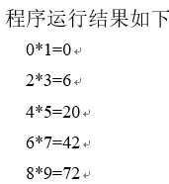
zip functions and loops
The zip() function packs the corresponding elements of multiple iterable objects into a single tuple and returns an iterable object. If the number of elements is not the same, then the list is returned with the same length as the shortest object.
Decompression of tuples into lists can also be achieved using the operator *
[Example 3.25] The zip function and parallel loops
>>> x = [1, 2, 3]
>>> y = [4, 5, 6]
>>> zip(x, y) #output: <zip object at 0x000001E663DEB988>
>>> list(zip(x, y)) #Output: [(1, 4), (2, 5), (3, 6)]
>>> a, b = zip(*zip(x, y))
>>> a, b # Output: ((1, 2, 3), (4, 5, 6))
evens = [0, 2, 4, 6, 8]
odds = [1, 3, 5, 7, 9]
for e, o in zip(evens, odds).
print("{0}*{1}={2}".format(e, o, e*o))

Slide 36
The map function and loops
The map(func, seq1[, seq2,...]) function applies func to each element of seq and returns the results of all calls as iterable objects. If func is None, it is equivalent to the zip() function.
[Example 3.26] Map Function and Loop Example
>>> list(map(abs, [-1, 0, 7, -8])) # Calculate the absolute value. Output: [1, 0, 7, 8]
[1, 0, 7, 8]
>>> list(map(pow, range(5), range(5))) # Calculate the powers of multiplication. Output: [1, 1, 4, 27, 256]
[1, 1, 4, 27, 256]
>>> list(map(ord,'abcdef')) # Compute the ASCII code. Output: [97, 98, 99, 100, 101, 102]
[97, 98, 99, 100, 101, 102]
>>> list(map(lambda x,y:x+y,'abc','de')) # String splicing. Output: ['ad', 'be']
['ad', 'be']

Slide 37
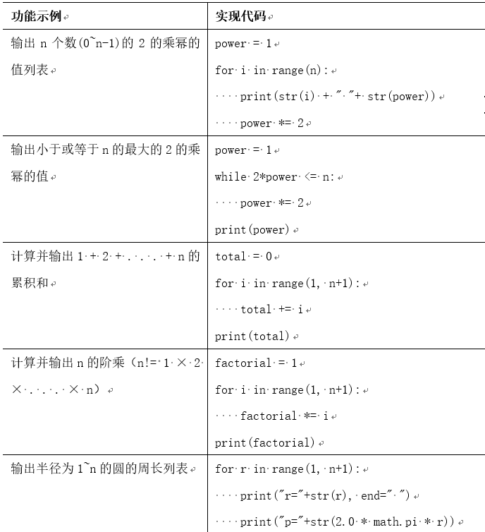
Typical Sample Code for Loop Statements

Slide 38

Comprehensive examples of cyclic structures (1)
[Example 3.27] Using Newton's iterative method to solve for square roots
Computing the square root of a positive real number a can be implemented using Newton's iterative method: first assume t = a and start the loop. If t = a/t (or is less than the tolerance), then t equals the square root of a, and the loop ends and returns the result; otherwise, assign the average of t and a/t to t and continue the loop
EPSILON = 1e-15 #tolerance
a = float(input("Please enter a positive real number a:")) # positive real number a
t = a # Assume that the square root t = a
while abs(t - a/t) > (EPSILON * t).
t = (a/t + t) / 2.0 # Assign the average of t and a/t to t
print(t) #Output the square root of a

Slide 39
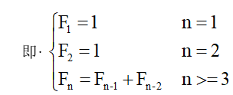
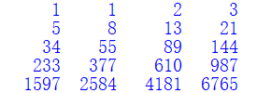
Comprehensive examples of cyclic structures (2)
[Example 3.28] Display the first 20 terms of the Fibonacci series: 1, 1, 2, 3, 5, 8, ......
f1 = 1; f2 = 1
for i in range(1, 11):
print(str.format("{0:6}{1:6}", f1, f2), end=" ") #Output 2 numbers at a time, each number occupies 6 digits, separated by spaces
if i % 2 == 0: print() #Show 4 items followed by a newline
f1 += f2; f2 += f1

Slide 40
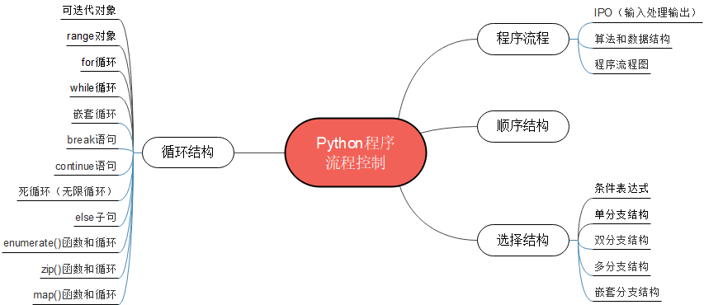
Summary of the chapter

Slide 41
3.5 Comprehensive application: complex graphic drawing with turtle module
[Example 3.29] Modify the code in [Example 2.26] to draw a square using a loop structure.
import turtle #Import the turtle module
p = turtle.Turtle() #create turtle object
p.color("red") #Set the color of the brush when drawing
p.pensize(3) #define the line width of the brush when drawing
turtle.speed(1) #define the speed of the drawing ("slowest" or 1)
p.goto(0,0) #move the turtle to the coordinate origin (0,0)
for i in range(4): # draw the four sides of the square
p.forward(100) # move forward 100
p.right(90) # rotate 90 degrees to the right

Slide 42
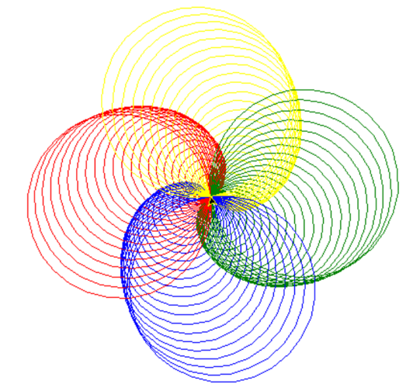
3.5 Comprehensive application: complex graphic drawing with turtle module
[Example 3.30] Using Turtle Drawing to draw circular spirals in each of the colors red, blue, green, and yellow (spiral.py)
import turtle #Import the turtle module
p = turtle.Turtle() #create turtle object
p.speed(0) #define the speed of the drawing ("fastest" or 0 for fastest)
colors = ["red", "blue", "green", "yellow"] #red, blue, green, yellow
for i in range(100): #i=0~99
p.pencolor(colors[i%4]) #set the brush color (red or blue or green or yellow)
p.circle(i) #draw circle
p.left(91) # rotate 91 degrees to the left

Slide 43
Case Study: Implementing an Image Processing Algorithm Using Nested Loops
This chapter case study uses the methods getpixel() and putpixel() of the Image class of the PIL.Image module of the Python third-party image-processing library Pillow to read and modify the color value (pix) of a pixel at a specific location (loc), and then implements the basic algorithms of image processing using nested loops with the goal of providing students with an in-depth understanding of the Python data structures and basic algorithmic processes
The solution and source code etc. of the case studies are provided in electronic format, please scan the QR code in the tutorial for details

Slide 44
Case Study: Implementing an Image Processing Algorithm Using Nested Loops
[Example CS3.1] Implement the image copy function copy(), input the original image object, return the copied image object (image_process.py)
[Example CS3.2] Implementing the image cropping function crop(), which takes an original image object as input and returns a cropped image object (image_process.py)
[Example CS3.3] Implement the flip() function to flip an image horizontally or vertically, input the original image object, and return the image object after flipping it horizontally or vertically (image_process.py)

Slide 45
Case Study: Implementing an Image Processing Algorithm Using Nested Loops
[Example CS3.4] implement the function rotate() to rotate an image 90 degrees counterclockwise or clockwise, input the original image object, return the image object after rotating 90 degrees counterclockwise or clockwise (image_process.py)
[Example CS3.5] implement the smooth image filter function smooth(), input the original image object, return the smooth filtered (image_process.py) image object

Slide 46
Thank!

